Slide 1

Sobresaliendo con la Educacion
(Achieving Success in Education)
Parents Education Conference
November 19, 2022 - 9:00 – 2:30
Isbell Middle School

Slide 2

Conference Objectives
Elevate appreciation of children as a community asset
Strengthen parent engagement with
ECE… and SPUSD, providers & CBOs
Provide info on ECE-related topics
Celebrate local culture
Acknowledge “International Rights
of Children” Day” (November 20th)

Slide 3
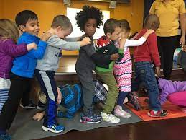
“Sobresaliendo” Elements
Language: Spanish with English translation available.
Target population: Spanish-dominant families
with ESL students
Workshops:
- ECE & Isabella Project
- District programs: TK, PK and Dual Language
- Parent engagement with education
--Socio-Emotional development
- Rights of Children including their protection
- Positive parenting
- Fun educational activities to help your child at home

Slide 4

ECE environments as protective experiences
Socio-Economic Challenges = Adverse
Childhood Experiences (ACEs)
40-50% of SP children experience poverty
Majority of Latino children are U.S. born
Low rate of utilization of government services
40-50$ of SP children have undocumented parent
Fear, food and housing insecurity lead to mental
health issues
Isabella… continue to promote/nurture safety and stability!

Slide 5
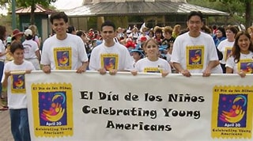
To be continued …
- Continue collaboration with
SPUSD & other providers
- Strategize to continue resource
development
- Planning February Conference
based on parent and
provider feedback

